Slide 1

Predicting customer buying behaviour
04/07/2024

Slide 2
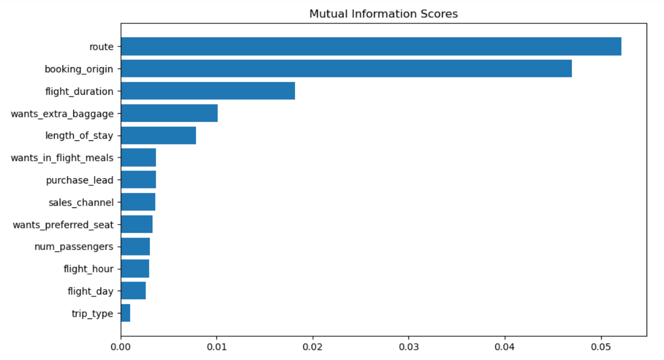
predictive model to understand factors that influence buying behavior
We have trained the data set with Random forest classifier model and received
ACCURACY: 85.41
AUC SCORE: 0.554
Top 6 features which influence Customer buying behavior
route
booking_origin
flight_duration
wants_extra_baggage
length_of_stay
Wants_in_flight_meals
We need to increase the AUC score.

